Slide 1


openEO Platform – Basic Training – 06th November 2023
Benjamin Schumacher (EODC)
Notes:
IMPORTANT: Ask for Experiences with Python / JupyterLab / Github!
Consortium of different project partner
-in-kind support by GEO.

Slide 2

What programming / EO experience do you have?
https://forms.office.com/r/mArLqhMbY1
Notes:
General overview: federated platform for unified access and analystics of EO data from different backends

Slide 3
Let’s have a look at the results

Slide 4

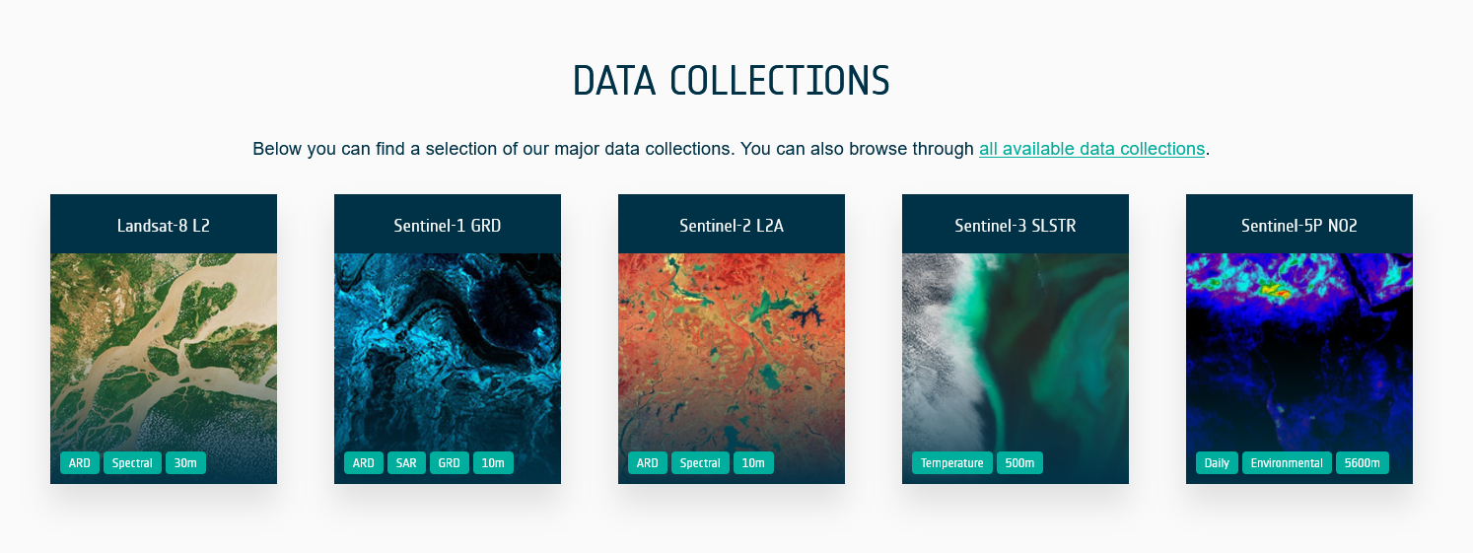
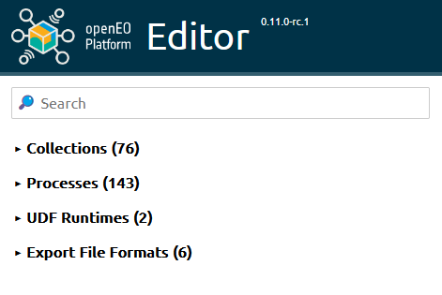
What is openEO Platform?
-> openEO Platform provides intuitive programming libraries to process a wide variety of Earth Observation datasets.
-> Run your earth observation analysis on our federated infrastructure!
Notes:
General overview: federated platform for unified access and analystics of EO data from different backends

Slide 5
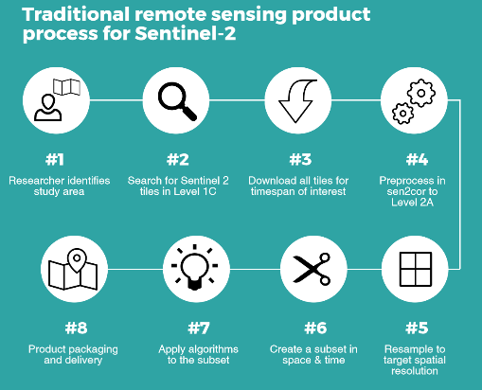
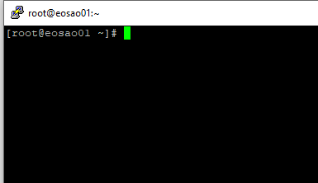

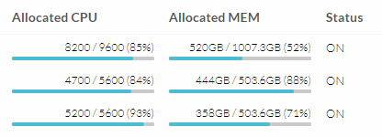
Why do we need openEO? The Data Management Burden…
Process 1
Thread 1
Thread 2
Task 1
Task 2
Task 3
Process 2
Thread 1
Thread 2
Process 3
Thread 1
Thread 2
Credits: H. Kristen – ESA open Science 2017
Notes:
Benjamin
Long list of tasks in typical workflow e.g. using sentinel-2
And when you finally reach step 7 you get notified that your network storage is full ….
1.) you need to be familiar with platform specific setups
find the data under the correct path or download it
2.) setup your virtual compute resources and manage them wisely…
Prevalence of old Virtual Machine model (rather than dynamic resource allocation and scaling);
File-based storage and data access, rather than pixel-level flexibility and cloud native data structures;
3.) organize your processing efficiently yourself
If you have setup your processing this way, how can you share it with others easily?
How can you transfer this to a different cloud infrastructure?

Slide 6
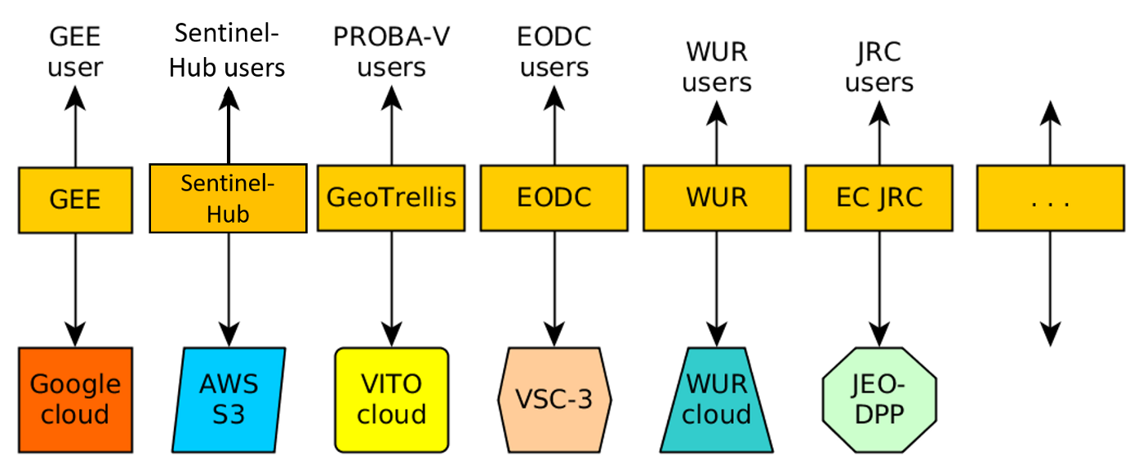
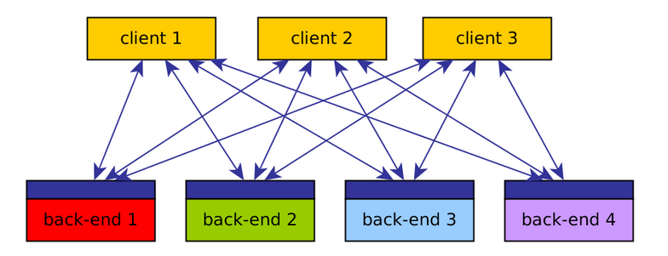
How does it work?
Situation before openEO:
openEO API:
Notes:
OpenEO API Horizon 2020 project:
- more and more data being acquired every day --> local processing less and less feasible (larger periods/areas) --> big EO cloud back ends (data access/processing capabilities) --> pass code etc to the backend and only download intermediat or final results
- advantages: less data transfer, less resource consumption on user side, avoid idle resource usage --> lower costs
- different companies, different busines models, processes and APIs are different and comparing backends in terms of functionality, cost and result was quite a tedious business
- goal developing a common language to connect to various cloud GIS backends

Slide 7
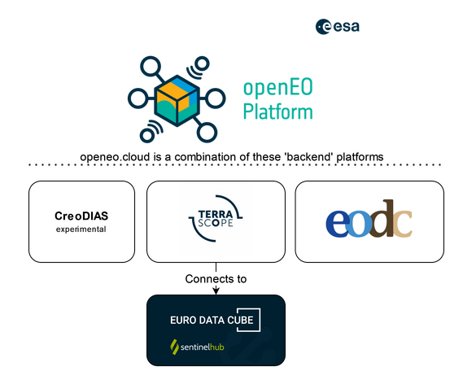
How does it work?
openEO API:
openEO Platform:
Client 1
Client 2
Added aggregation layer
Client 3
Notes:
openEO Platform:
unified access
not one account needed per backend but one unified account
Advantage:
Only 1 account needed
Growing number of EO data collection (more than 70)
Combined processing capabilities and resources
Transparent (open source code, reproducible results, clear and prior cost estimation)
Simple (dynamic resource allocation, federated cloud environment, pythonic programming syntax)
Processing data form pixel to continental scale

Slide 8
How does it work?
Situation before openEO:
openEO API:
Notes:
Benjamin
OpenEO API Horizon 2020 project:
- more and more data being acquired every day --> local processing less and less feasible (larger periods/areas) --> big EO cloud back ends (data access/processing capabilities) --> pass code etc to the backend and only download intermediat or final results
- advantages: less data transfer, less resource consumption on user side, avoid idle resource usage --> lower costs
- different companies, different busines models, processes and APIs are different and comparing backends in terms of functionality, cost and result was quite a tedious business
- goal developing a common language to connect to various cloud GIS backends

Slide 9
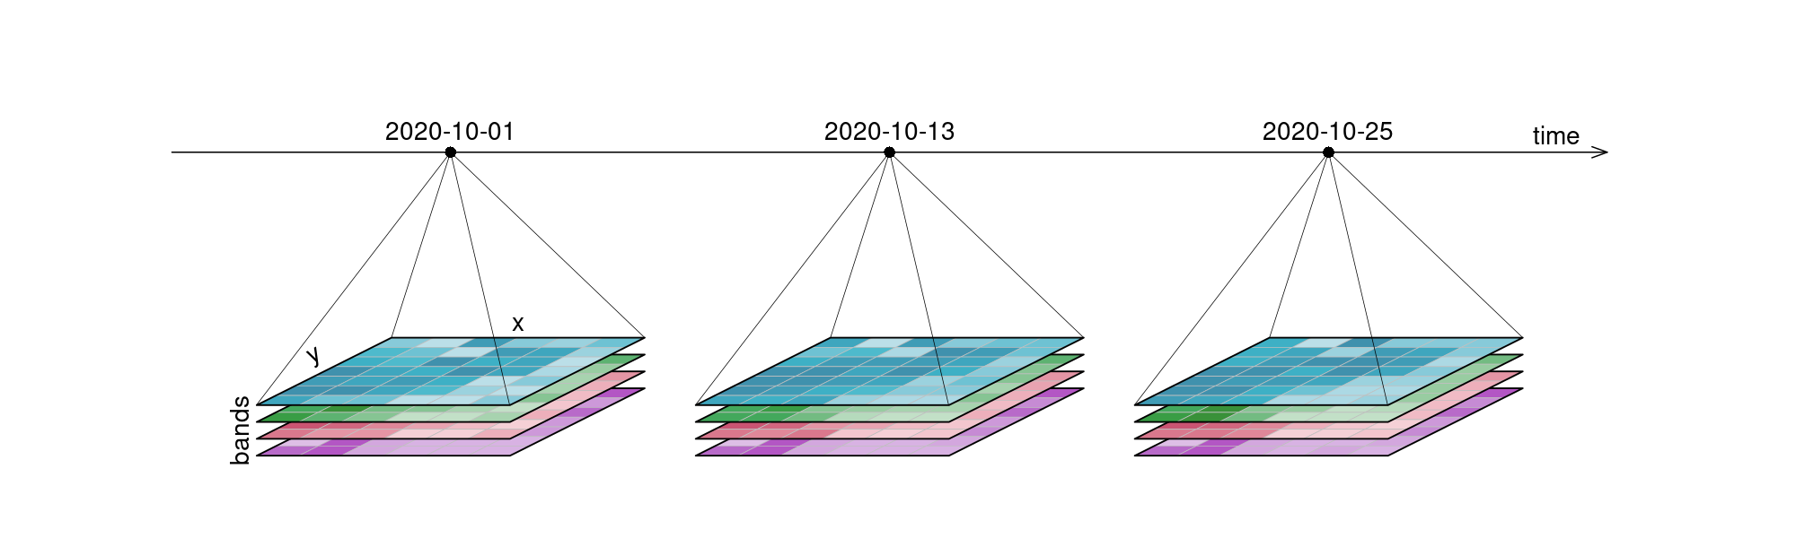
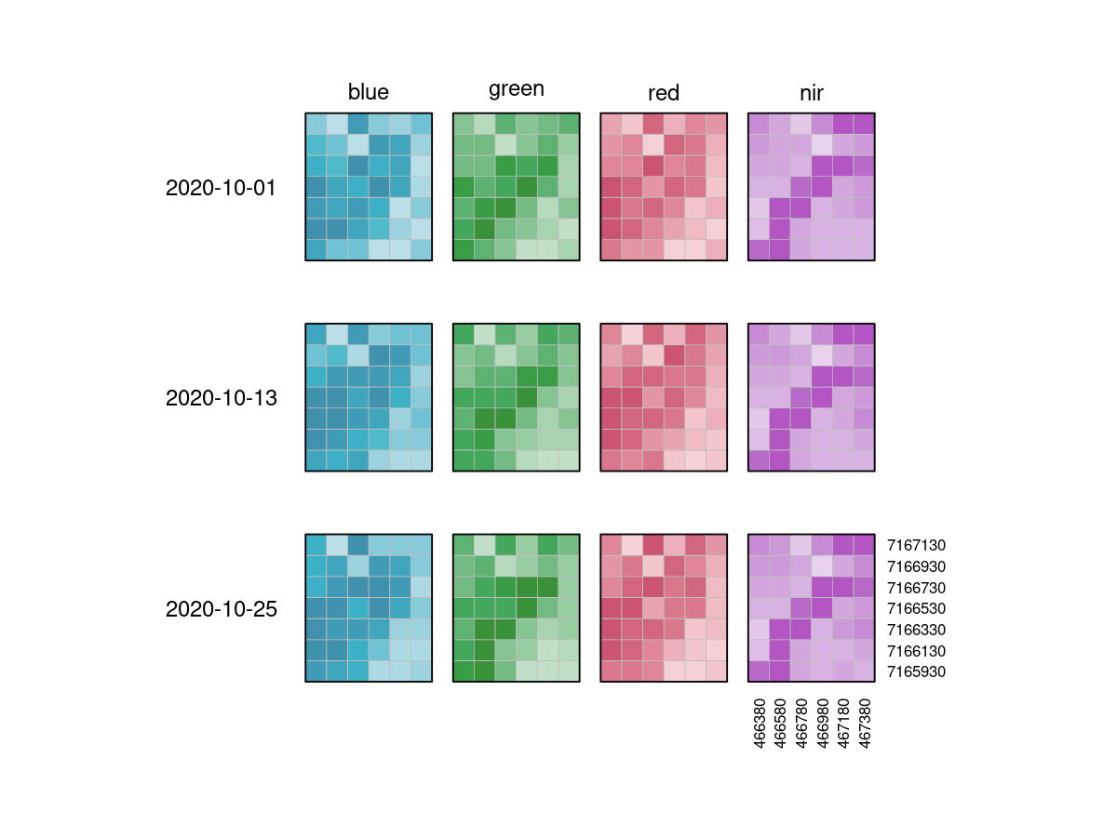
Concepts of openEO - Datacubes
-> multidimensional arrays with one or more spatial or temporal dimension
-> Data in OpenEO is represented in this way
-> Any representation of the data cube is fine
(meaning – dimensions can be switched in display)
Notes:
-> Datacubes are multidimensional arrays with one or more spatial or temporal dimension(s).
-> data is represented in OpenEO in this way

Slide 10
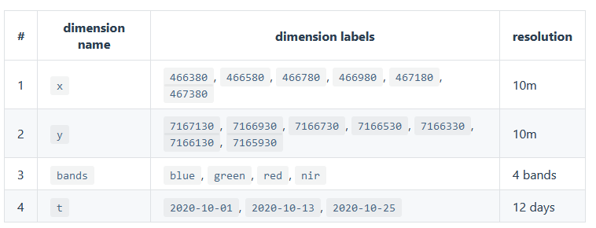
Concepts of openEO – Datacubes - Dimensions
Properties:
name
axis / number
type (spatial/temporal/bands/other)
extents or nominal dimension labels
reference system / projections
resolution
-> be careful with dimensions and your coordinate reference system – location x,y change in different CRS
-> be carful with changing data types of dimensions – do this only if the backend supports it
Notes:
Names: x, y, t and bands; But technically also could be pressure level represented or others
Data types: strings (also timestamps), numerical

Slide 11
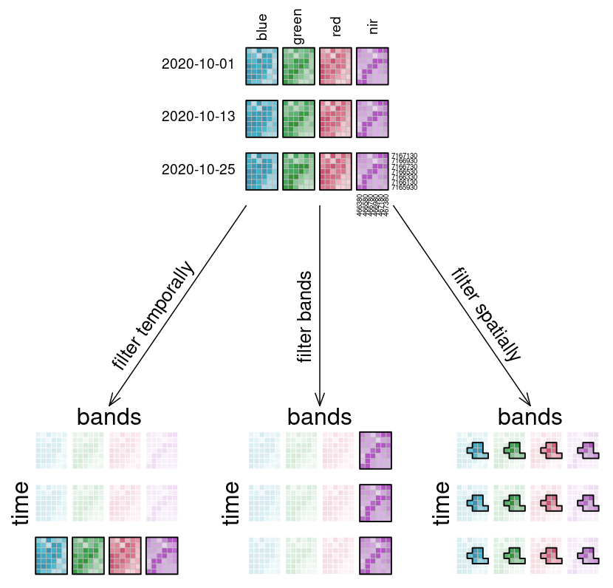
Concepts of openEO – Datacubes - Filters
Filters:
Filter temporal
Filter bands
Filter spatial
-> Data that satisfy the condition is returned
-> Datacube becomes smaller (selection process)

Slide 12
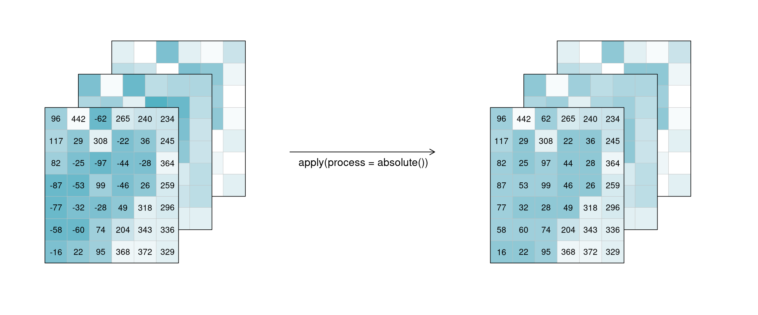
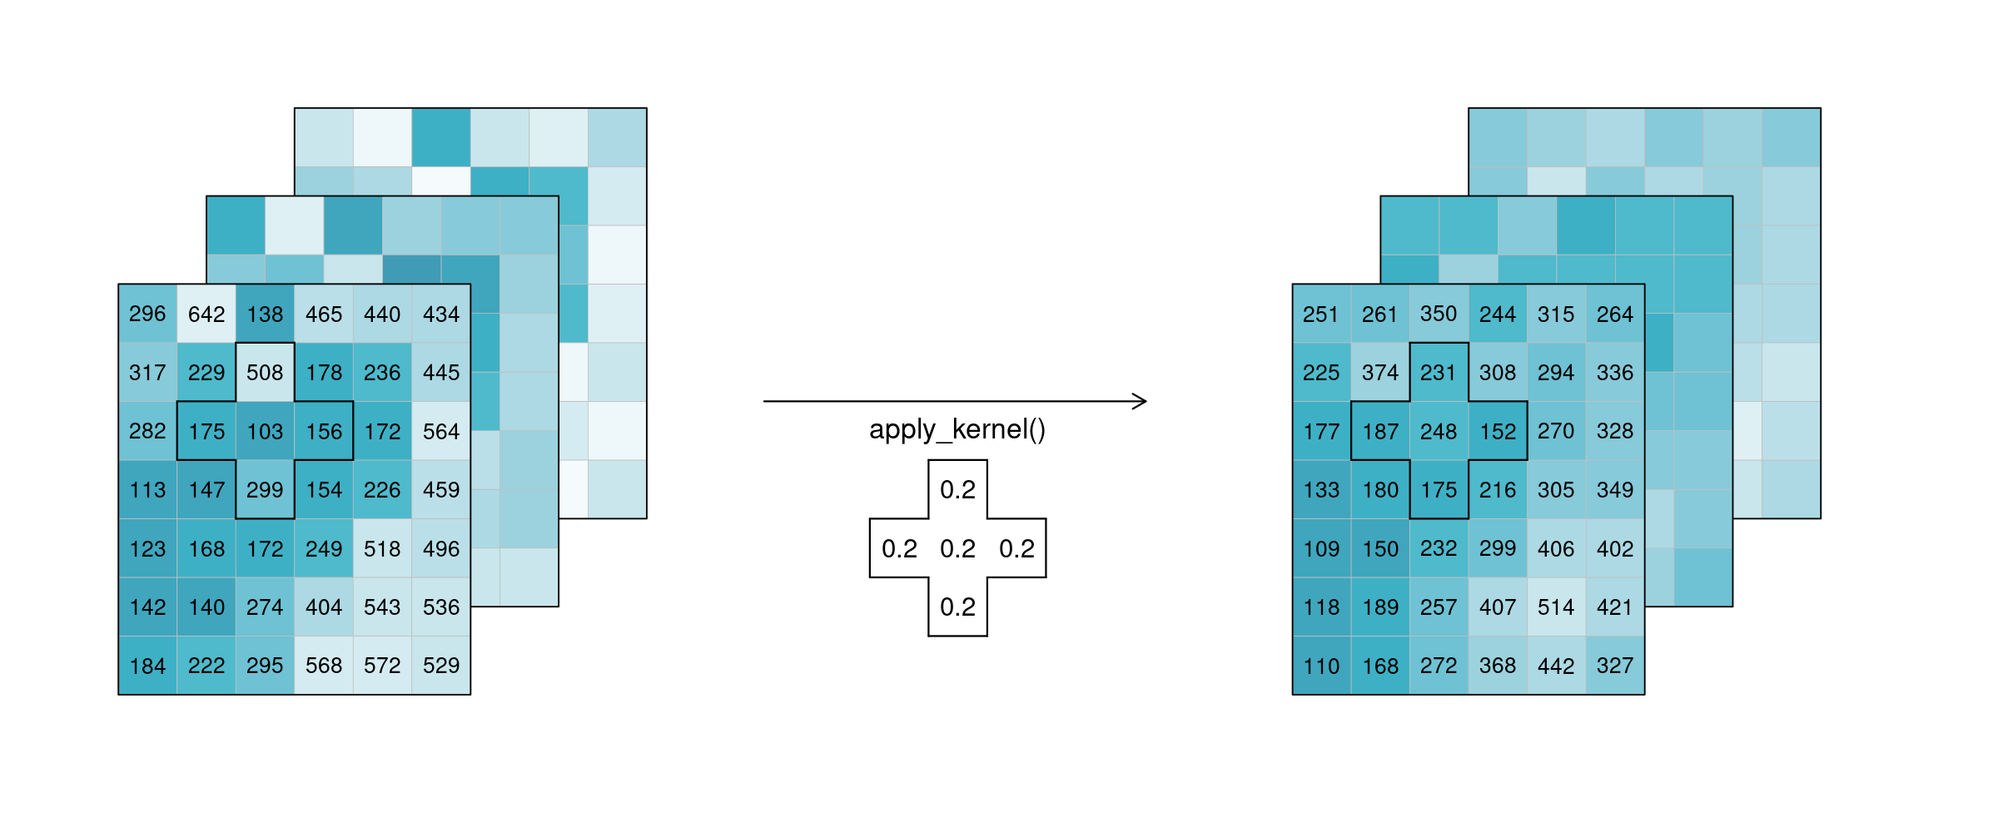
Concepts of openEO – Datacubes - Apply
Data manipulation:
absolute
Kernels
Neighborhoods
Temporal smoothing
Spatial smoothing
Notes:
Along each dimension

Slide 13
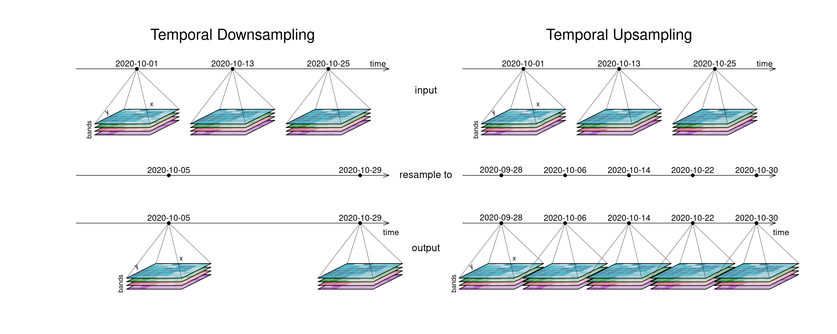
Concepts of openEO – Datacubes - Resample

Slide 14
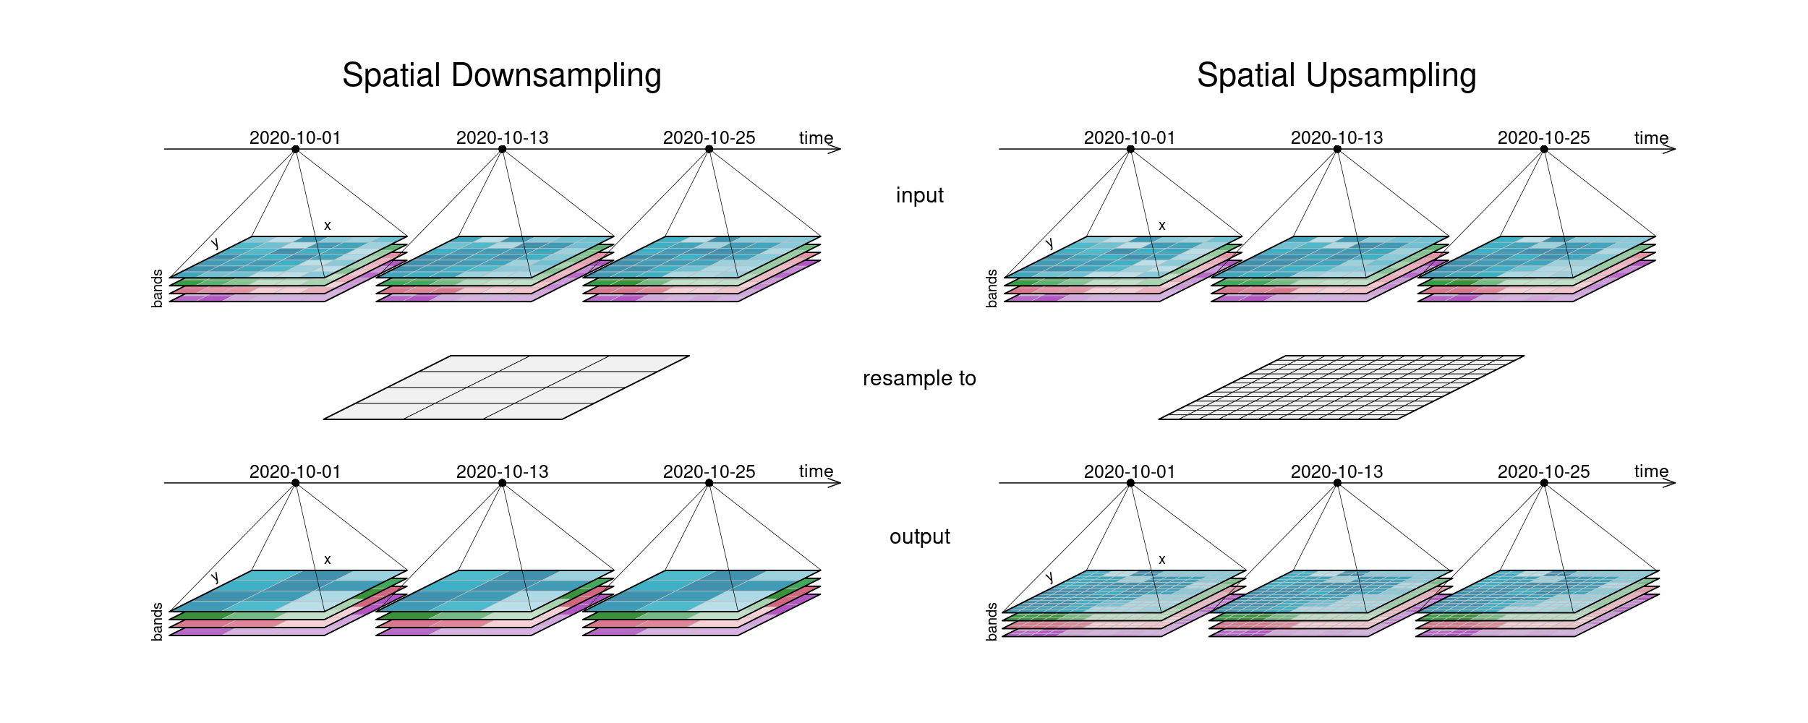
Concepts of openEO – Datacubes - Resample

Slide 15
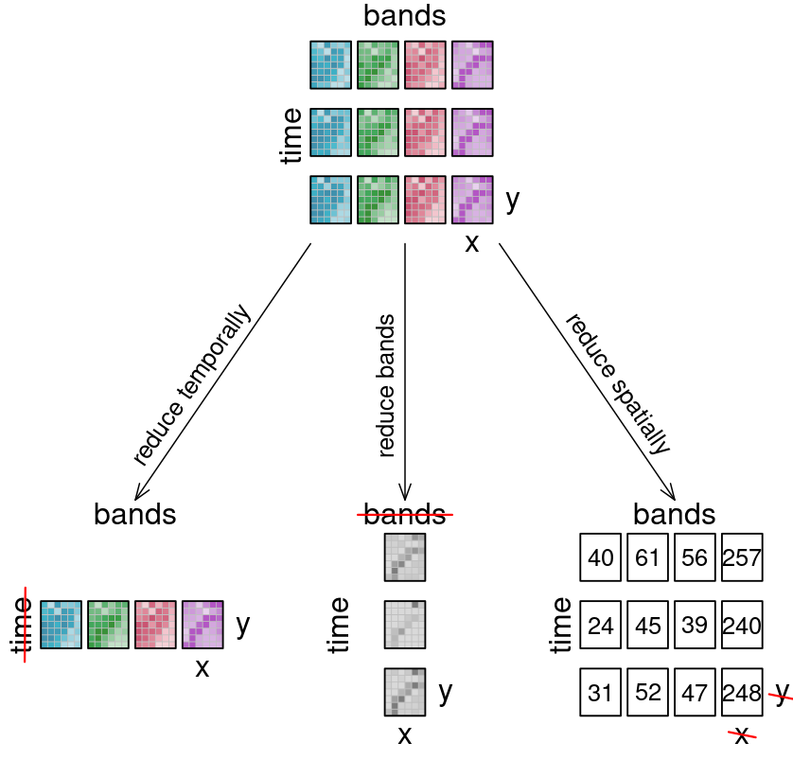
Concepts of openEO – Datacubes - Reduce
Reduce dimension:
Collapses one dimension and calculates a single result
Reduce function (e.g. mean, max, min, median…)

Slide 16
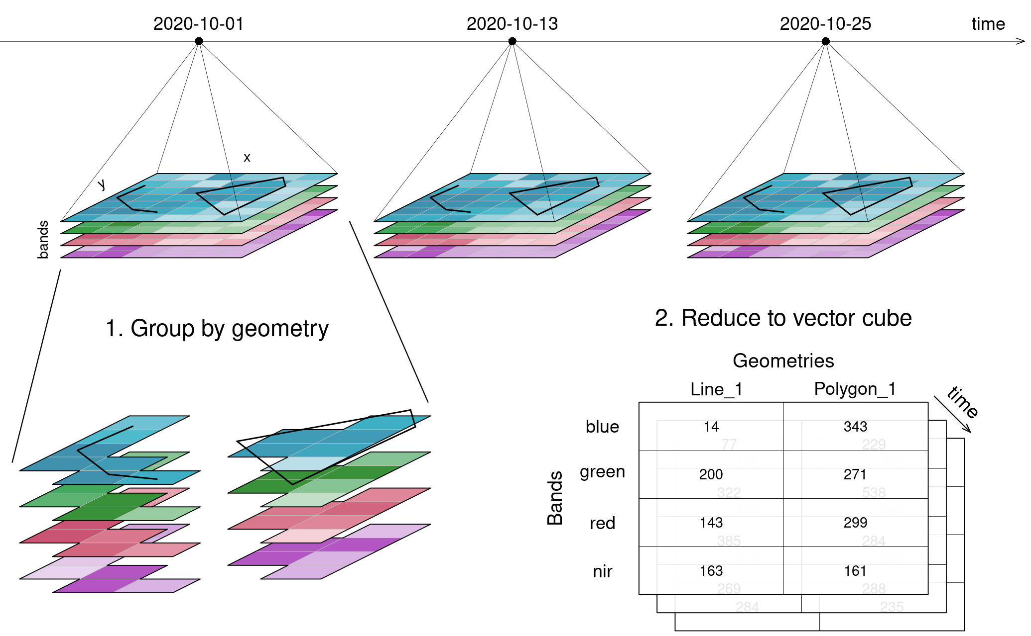
Concepts of openEO – Datacubes - Aggregate
Aggregate Spatial / Temporal:
Groups over time or geometry and collapses similarly to reduce to a single outcome

Slide 17
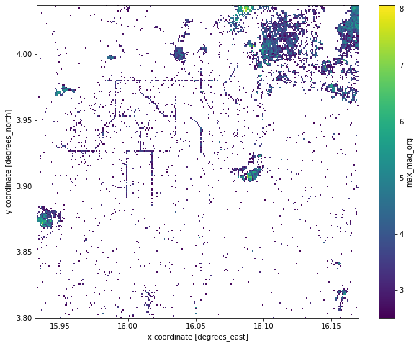
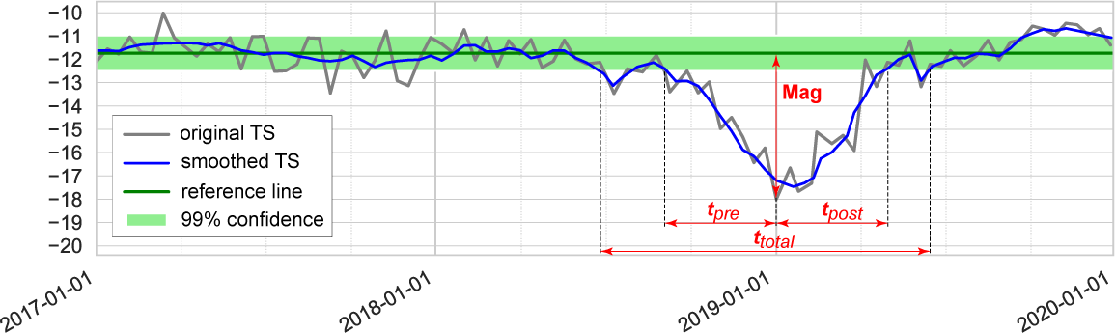
“Use Cases” from the community
Selective Logging Sites in the Central African Rep.
Disturbance Magnitude > 2.5 (dB)
Methodology: Sentinel-1 Signal Disturbance Features
Notes:
Jeroen

Slide 18
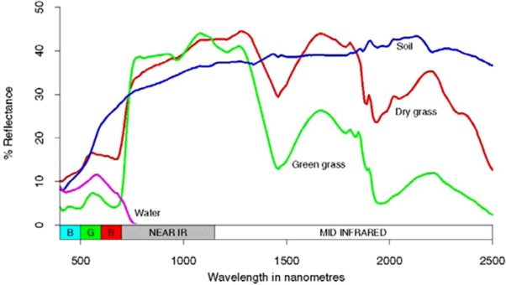
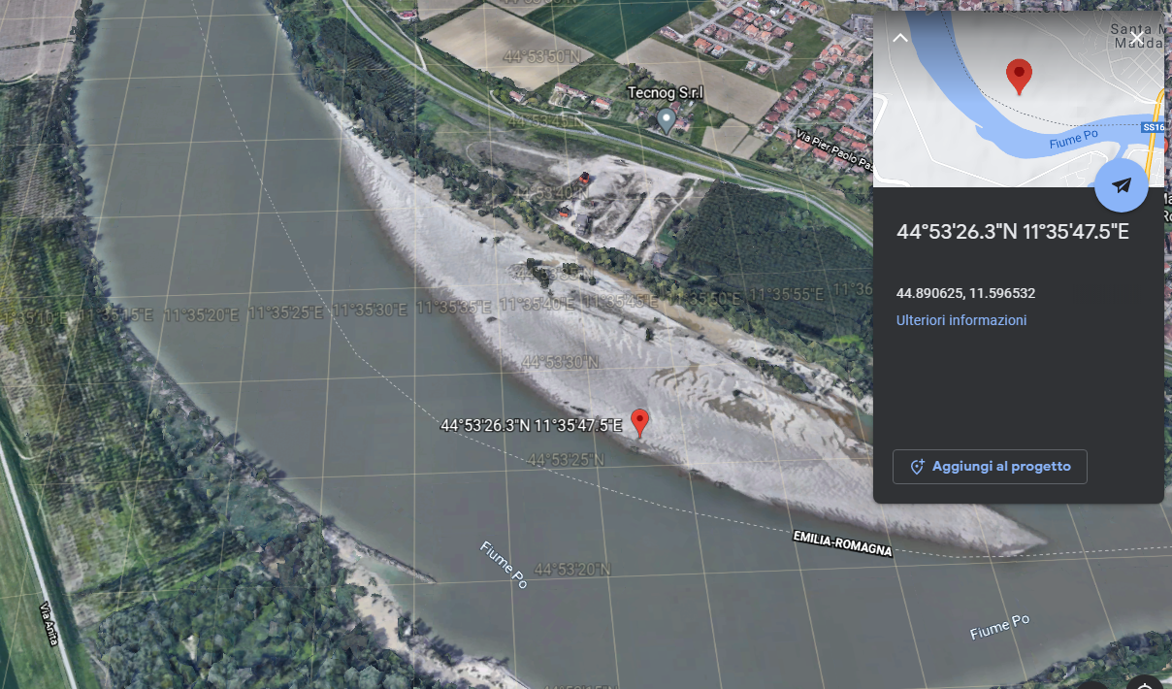
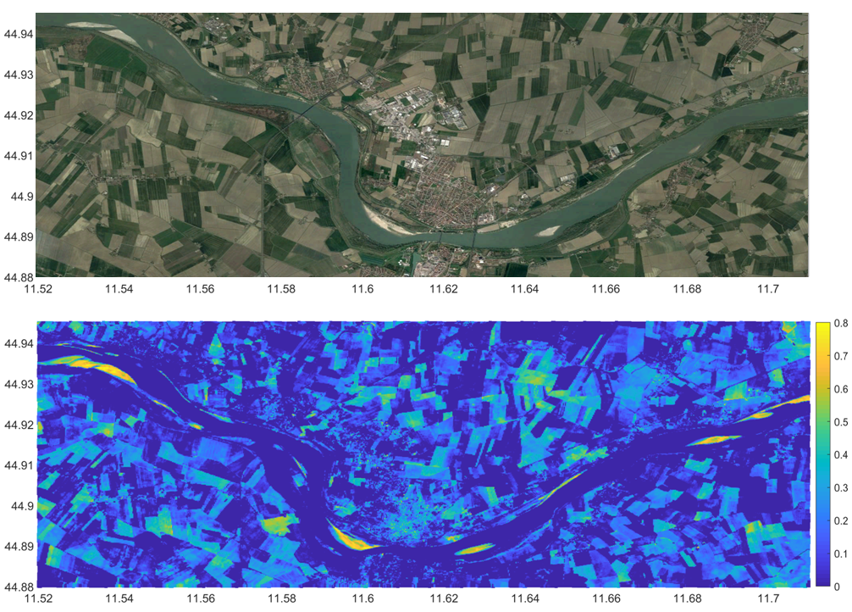
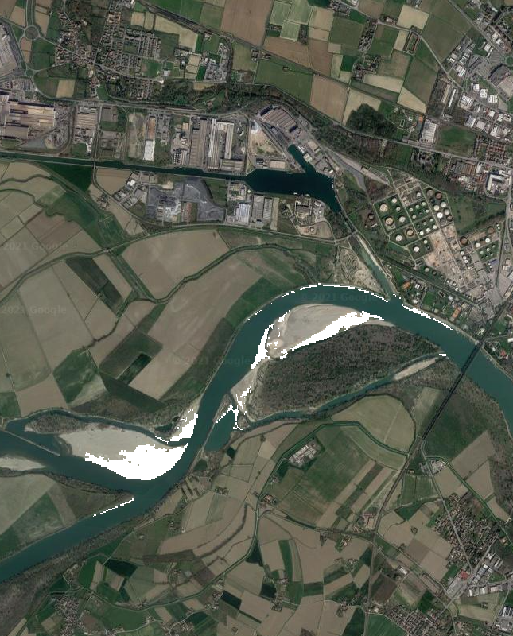
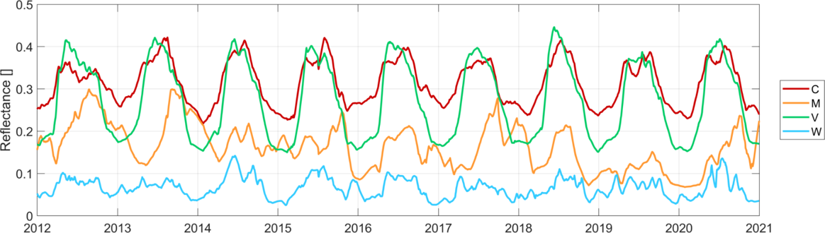
“Use Cases” from the community
River discharge from Sentinel 2 imagery
Notes:
Jeroen

Slide 19
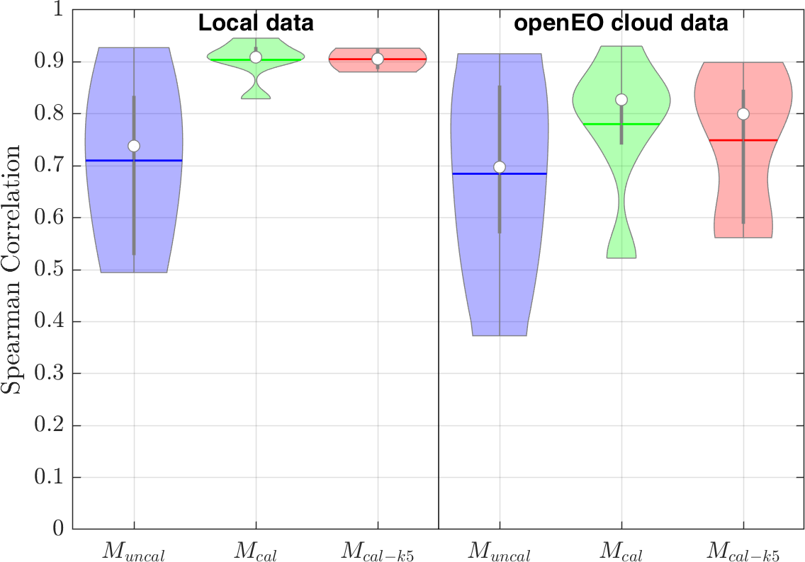
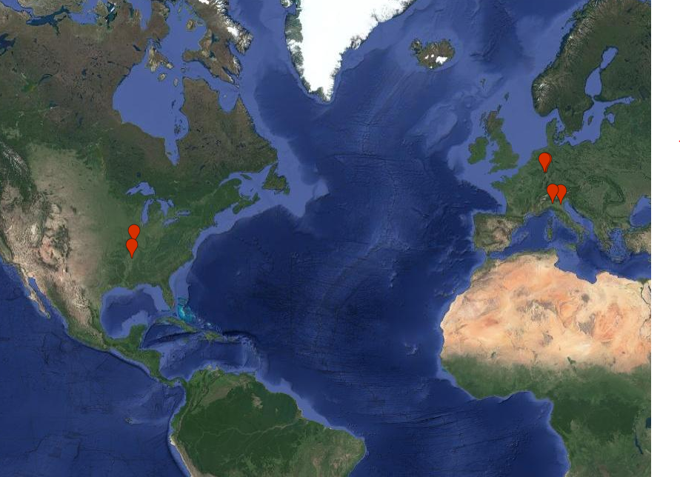
“Use Cases” from the community
Po (Italy): 2 stations
Rhein (Germany): 2 stations
Mississippi (USA): 2 stations
Notes:
Jeroen

Slide 20
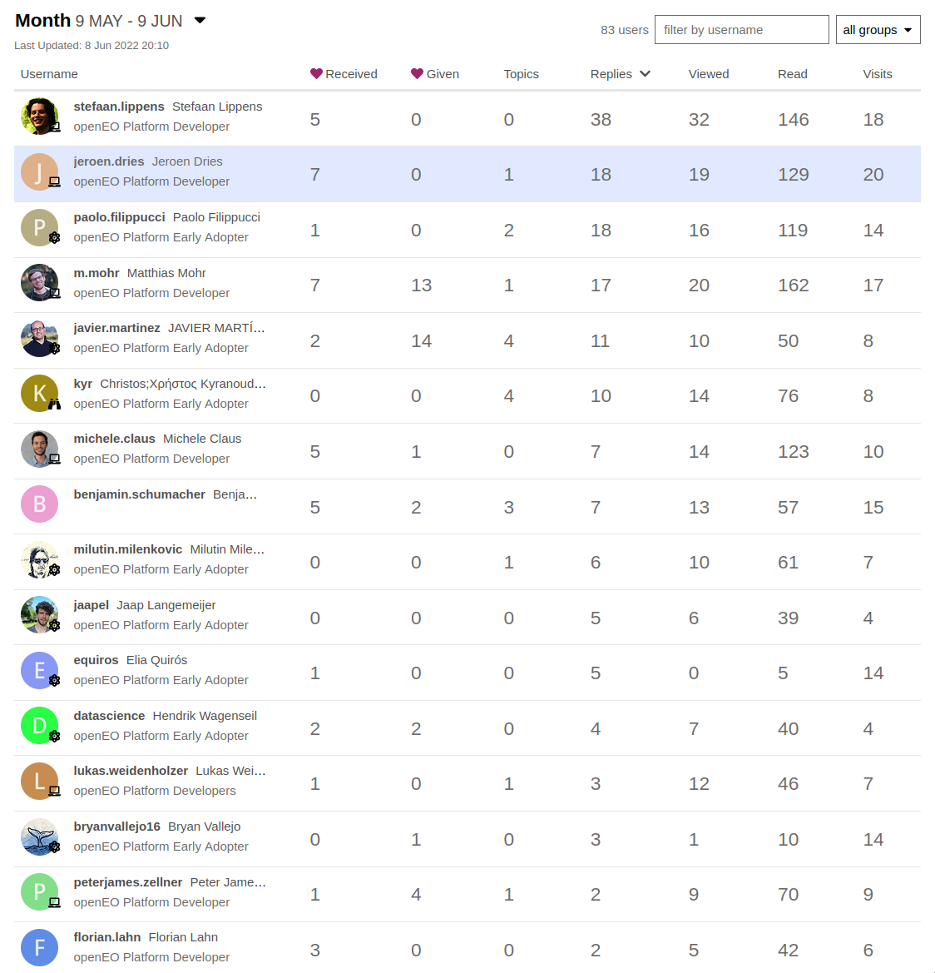
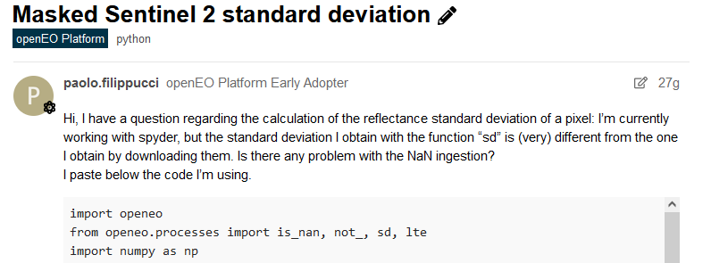
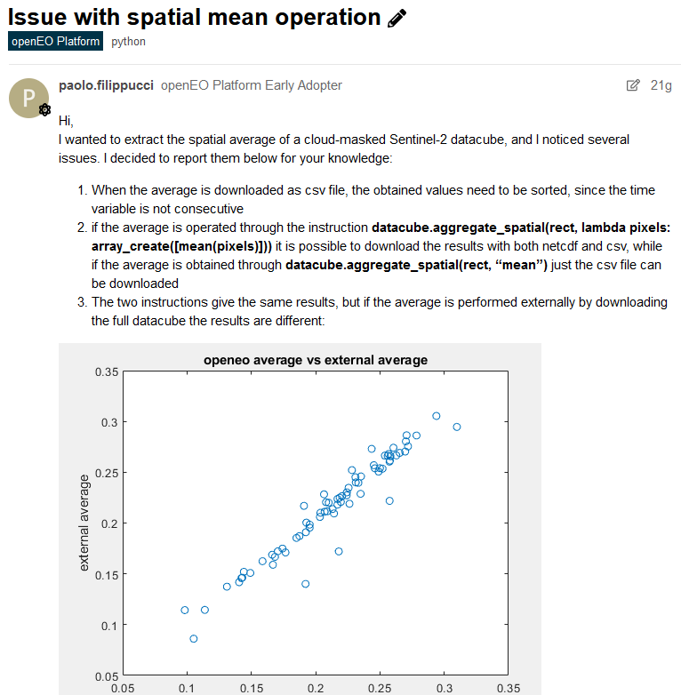
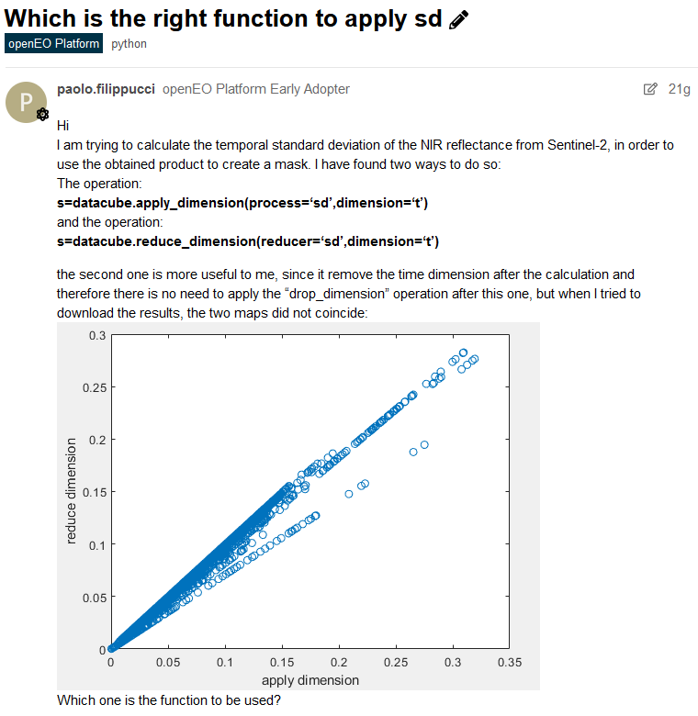
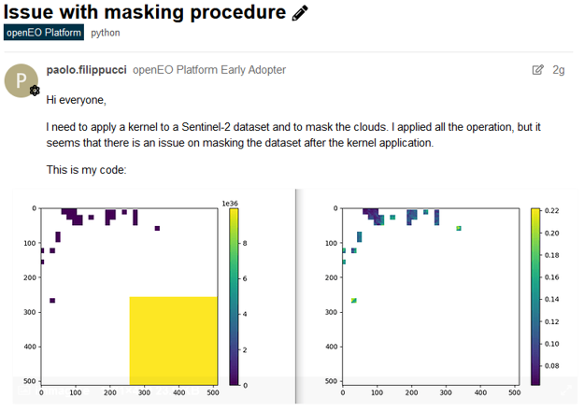
Active User Community
Notes:
Jeroen

Slide 21
What is openEO?
-> Representation of your EO Analysis in a common language. The analysis can be defined in any available client package!

Slide 22
ANNEX - Documentation
-> https://openeo.cloud/
Documentation:
-> openEO Platform: https://docs.openeo.cloud/
-> openEO: https://openeo.org/documentation/1.0/
Questions?
-> Forum: forum.openeo.cloud

Slide 23
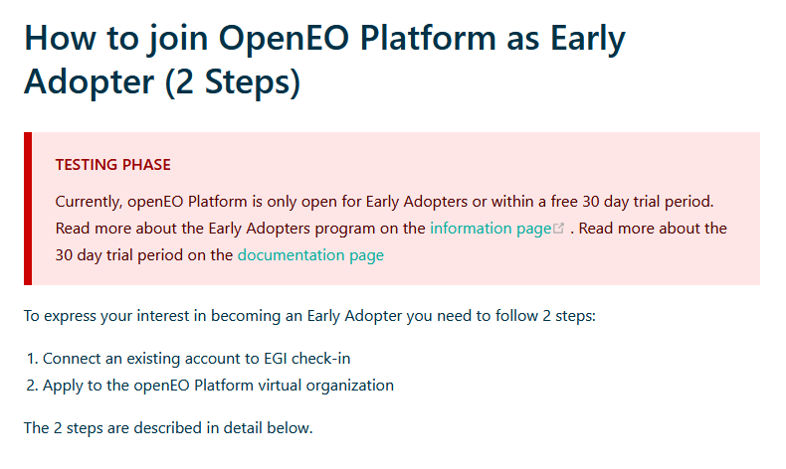
ANNEX - Registration
-> https://openeo.cloud/#plans
Follow the Step-by-Step Guide:

